Slide 1
CST 205 OOP :JAVA IO

Slide 2
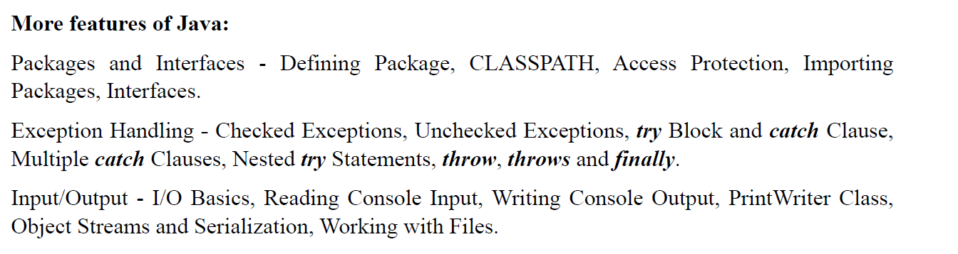
OBJECTIVE

Slide 3
OBJECTIVE
To explain Java’s basic I/O (input/output) system.
To summarize byte stream and character streams.
To illustrate reading console input and writing to console output.
To exemplify reading and writing to files.

Slide 4
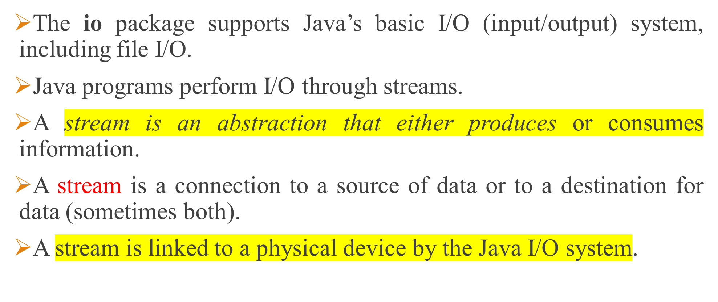
Introduction: Streams

Slide 5
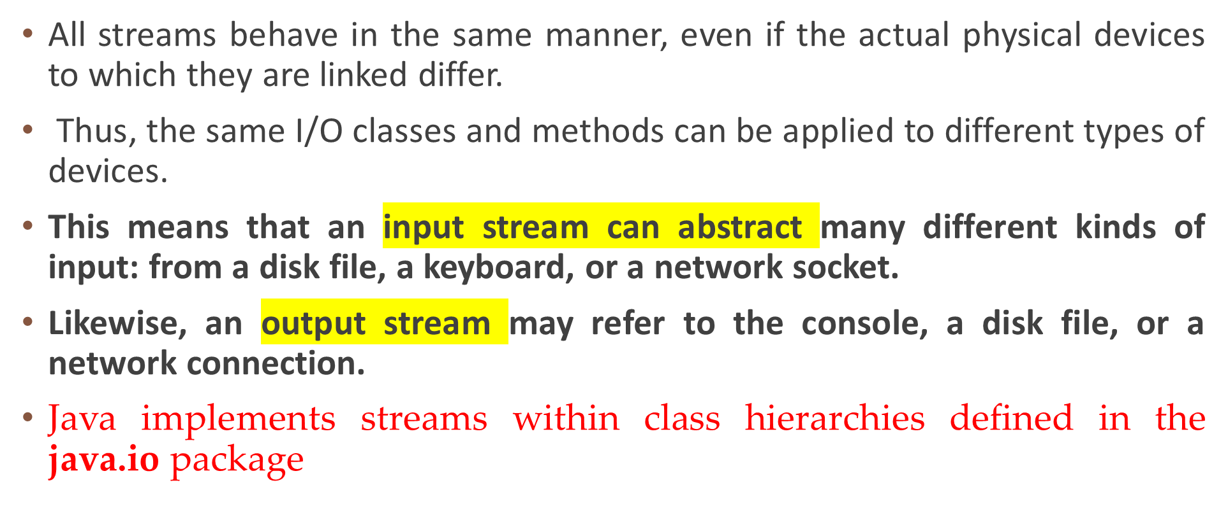
Introduction: Streams

Slide 6
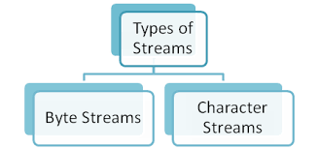
Introduction: Streams
Stream – A sequence of data.
Input Stream: reads data from source.
Output Stream: writes data to destination.

Slide 7
Types of Streams
There are 2 kinds of streams
  byte streams
  character streams
Byte streams provide a convenient means for handling input and output of bytes.
Byte streams create binary files; for example, when reading or writing binary data.
Character streams provide a convenient means for handling input and output of characters.
Character streams create text files.

Slide 8
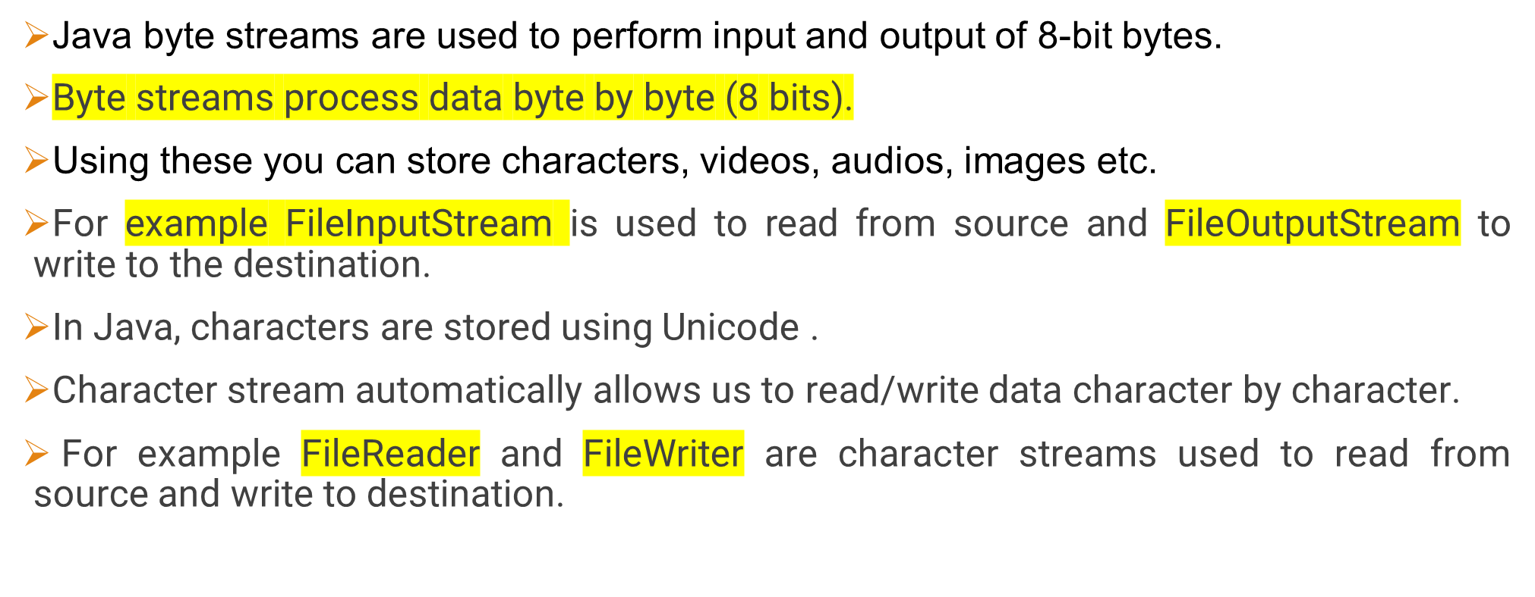
Types of Streams

Slide 9
Types of Streams
When to use Character Stream over Byte Stream?
In Java, characters are stored using Unicode conventions.
Character stream is useful when we want to process text files.
These text files can be processed character by character.
A character size is typically 16 bits.
When to use Byte Stream over Character Stream?
Byte oriented reads byte by byte.
A byte stream is suitable for processing raw data like binary files.

Slide 10
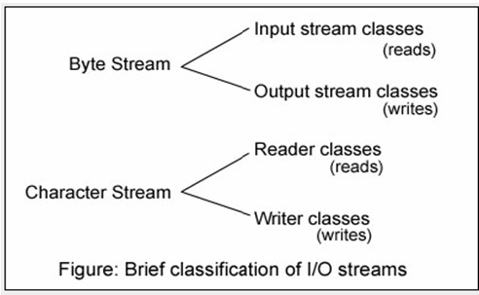
Types of Streams
Notes:
Names of character streams typically end with Reader/Writer and names of byte streams end with InputStream/OutputStream.
We use BufferedReader/BufferedWriter (for character stream) and BufferedInputStream/BufferedOutputStream (for byte stream) classes.
It is always recommended to close the stream if it is no longer in use. This ensures that the streams won’t be affected if any error occurs.

Slide 11
Byte Stream Classes
Byte streams are defined by using two class hierarchies.
InputStream and OutputStream.
The InputStream and OutputStream classes (abstract) are the super classes of all the input/output stream classes: classes that are used to read/write a stream of bytes.
Each of these abstract classes has several concrete subclasses that handle the differences among various devices, such as disk files, network connections, and even memory buffers.
To use the stream classes, we must import java.io.

Slide 12
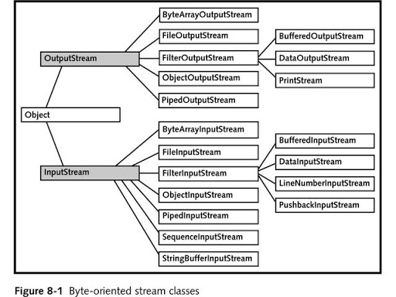
Byte Stream Classes

Slide 13
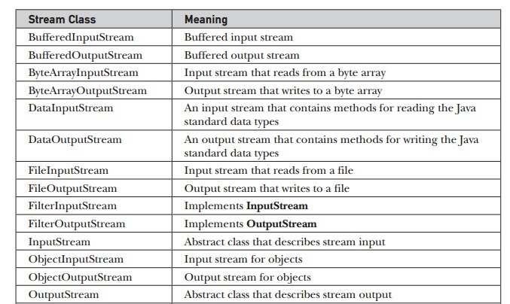
Byte Stream Classes in java.io

Slide 14
Byte streams
The abstract classes InputStream and OutputStream define several key methods that the other stream classes implement.
Two of the most important are read( ) and write( ), which, respectively, read and write bytes of data.
Each has a form that is abstract and must be overridden by derived stream classes.

Slide 15
Byte streams
InputStream
InputStream is an abstract class that defines Java’s model of streaming byte input. It implements the Closeable interface.
Most of the methods in this class will throw an IOException on error conditions.
OutputStream
OutputStream is an abstract class that defines streaming byte output.
Most of the methods in this class return void and throw an IOException in the case of errors.

Slide 16
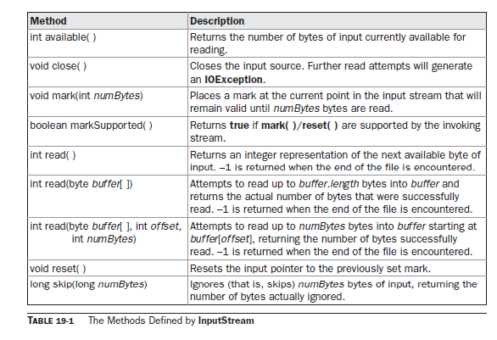
Byte streams :InputStream

Slide 17
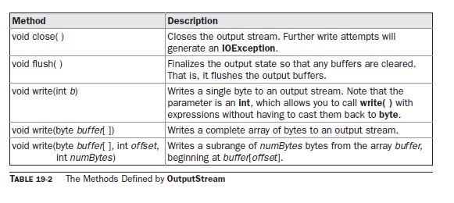
Byte streams :OutputStream

Slide 18
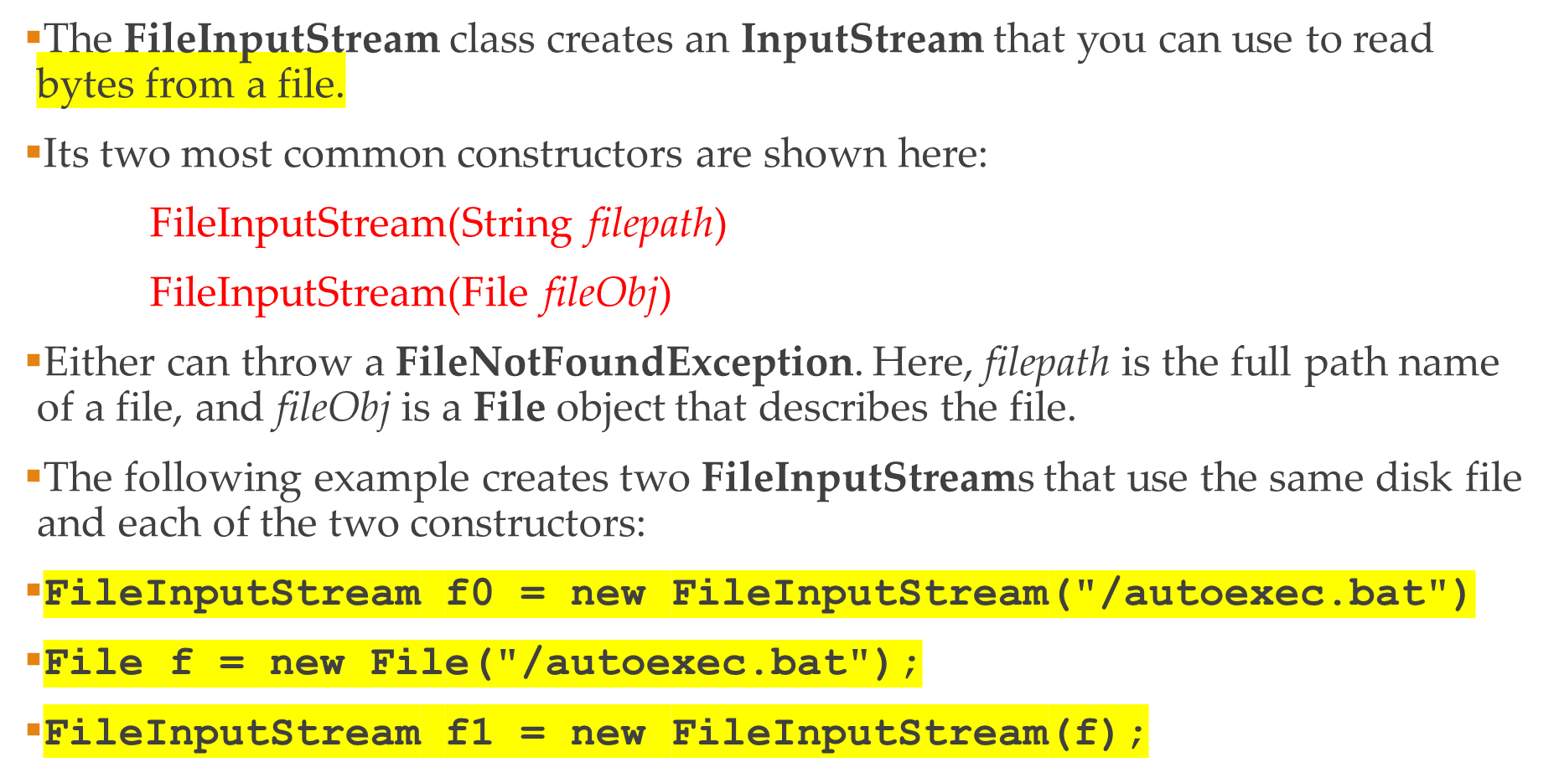
Byte streams :FileInputStream

Slide 19
Byte streams :FileOutputStream
FileOutputStream creates an OutputStream that you can use to write bytes to a file.
Its most commonly used constructors are shown here:
FileOutputStream(String filePath)
FileOutputStream(File fileObj)
FileOutputStream(String filePath, boolean append)
append is an optional boolean parameter. If it is set to true, the new data will be appended to the end of the existing data in the file. Otherwise, the new data overwrites the existing data in the file.
FileOutputStream(File fileObj, boolean append)

Slide 20
Byte streams :FileOutputStream
import java.io.FileOutputStream; public class Main { public static void main(String[] args) { String data = "This is a line of text inside the file."; try { FileOutputStream output = new FileOutputStream("output.txt"); byte[] array = data.getBytes(); // Writes byte to the file | output.write(array); output.close(); } catch(Exception e) { …. } } }

Slide 21
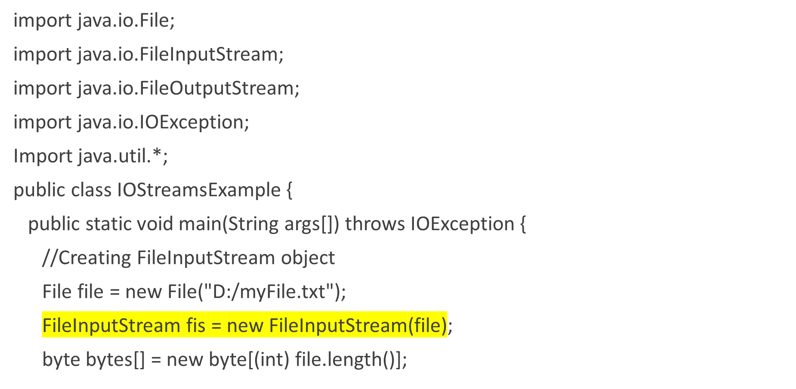
File streams

Slide 22
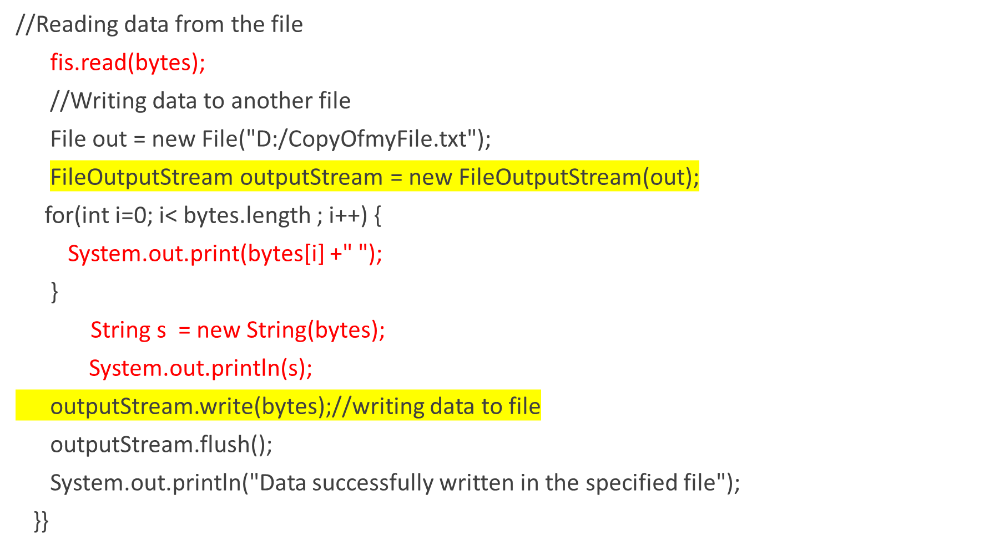

Slide 23
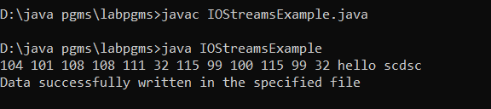
Byte streams

Slide 24
FILE
File class deals directly with files and the file system.
It describes the properties of a file itself. A File object is used to obtain or manipulate the information associated with a disk file, such as the permissions, time, date, and directory path, and to navigate subdirectory hierarchies.
The following constructors can be used to create File objects:
File(String directoryPath)
File(String directoryPath, String filename)
File(File dirObj, String filename)
File(URI uriObj)
directoryPath is the path name of the file, filename is the name of the file or subdirectory, dirObj is a File object that specifies a directory, and uriObj is a URI object that describes a file.

Slide 25
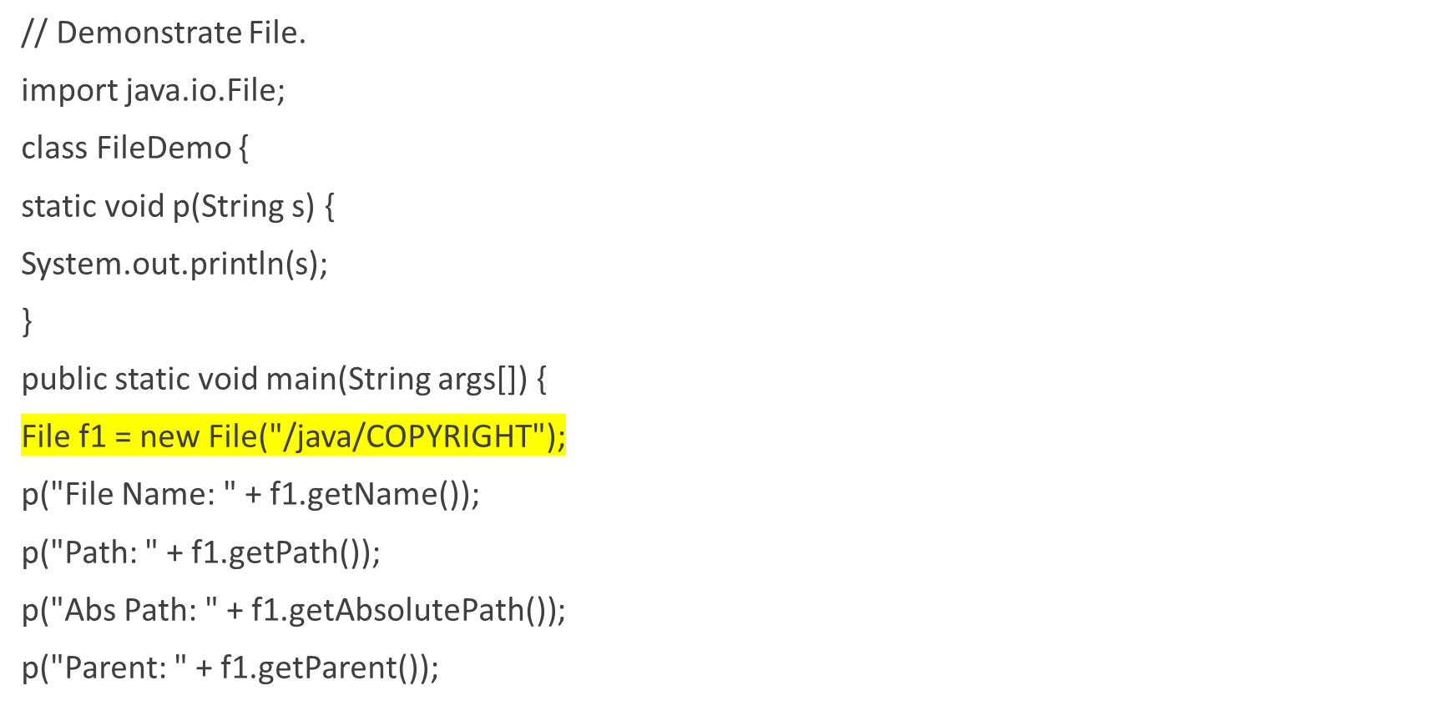
FILE

Slide 26
FILE
p(f1.exists() ? "exists" : "does not exist");
p(f1.canWrite() ? "is writeable" : "is not writeable");
p(f1.canRead() ? "is readable" : "is not readable");
p(f1.isFile() ? "is normal file" : "might be a named pipe");
p(f1.isAbsolute() ? "is absolute" : "is not absolute");
p("File last modified: " + f1.lastModified());
p("File size: " + f1.length() + " Bytes");
}
}

Slide 27
Character Stream Classes
Character streams are defined by using two class hierarchies.
At the top are two abstract classes: Reader and Writer.
These abstract classes handle Unicode character streams.
Java has several concrete subclasses of each of these.
These handle data in 16 bit Unicode. Using these you can read and write text data only.
The Reader and Writer classes (abstract) are the super classes of all the character stream classes: classes that are used to read/write character streams.

Slide 28
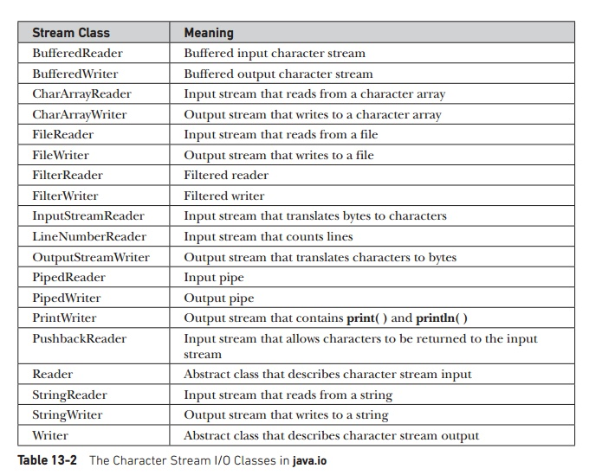

Slide 29
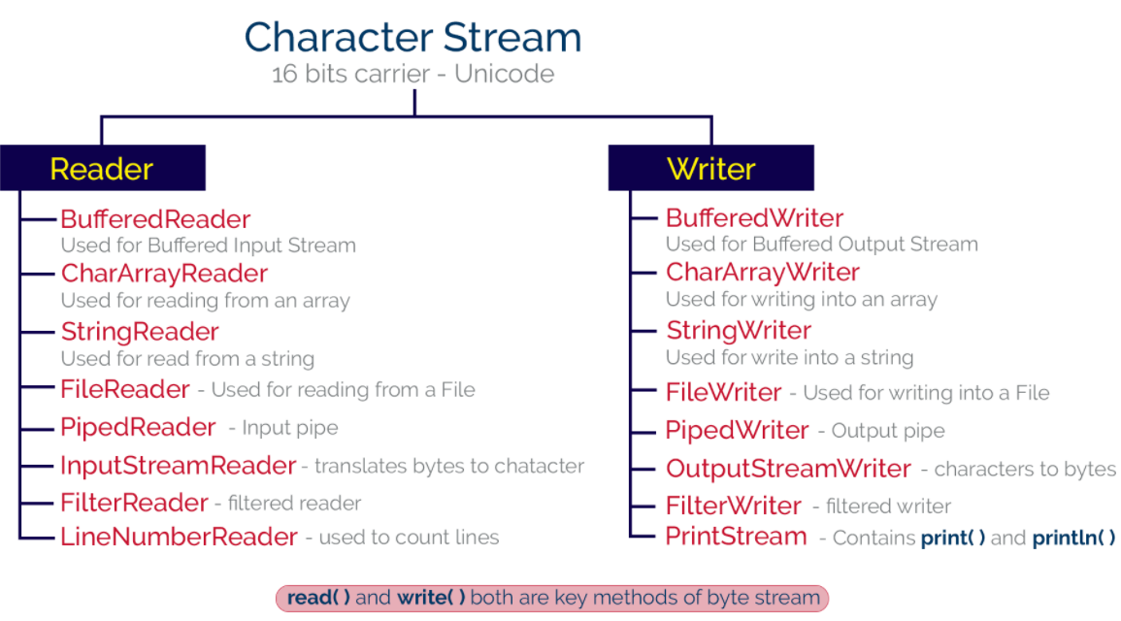

Slide 30
Character Stream
The abstract classes Reader and Writer define several key methods that the other stream classes implement.
Two of the most important methods are
read( ) and write( ), which read and write characters of data, respectively.
Reader Classes - These classes are subclasses of an abstract class Reader and they are used to read characters from a source(file, memory or console).
Writer Classes - These classes are subclasses of an abstract class, Writer and they used to write characters to a destination(file, memory or console).

Slide 31
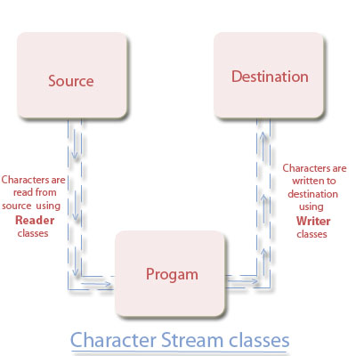
Character Stream

Slide 32
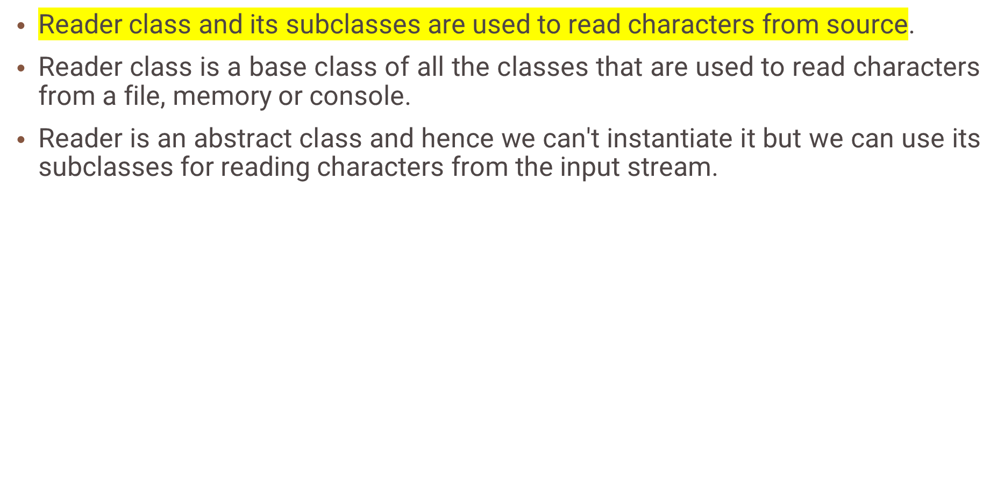
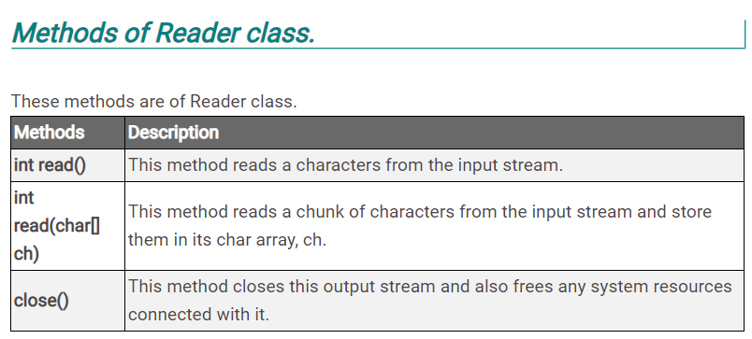
Reader

Slide 33
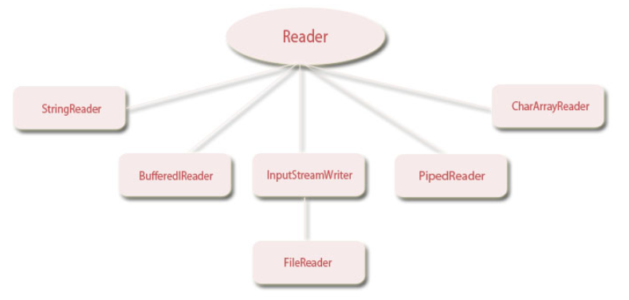
Hierarchy of Reader class

Slide 34
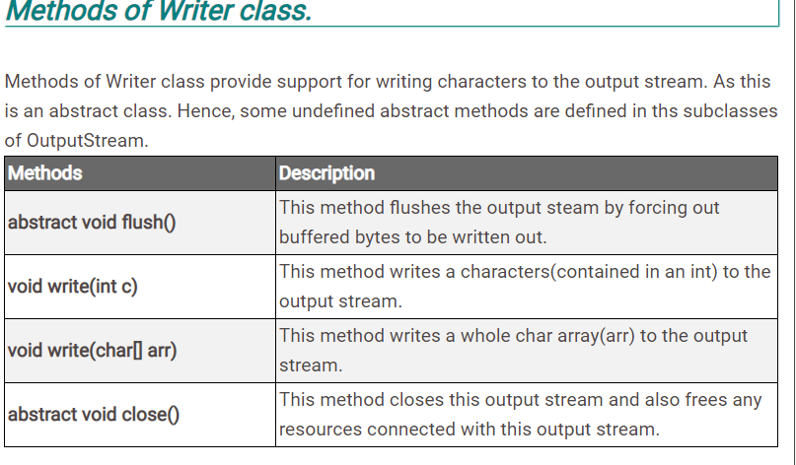
Writer
Writer class and its subclasses are used to write characters to a file, memory or console.
Writer is an abstract class and hence we can't create its object but we can use its subclasses for writing characters to the output stream.

Slide 35
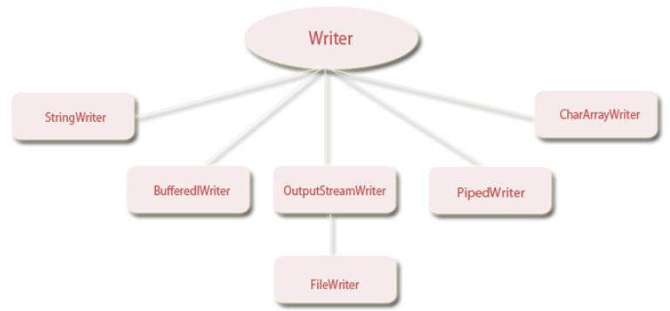
Hierarchy of Writer class

Slide 36
FileReader and FileWriter
The FileReader class creates a Reader that you can use to read the contents of a file. Its two most commonly used constructors are shown here:
FileReader(String filePath)
FileReader(File fileObj)
Either can throw a FileNotFoundException. Here, filePath is the full path name of a file, and fileObj is a File object that describes the file.
FileWriter
FileWriter creates a Writer that you can use to write to a file.
FileWriter(String filePath)
FileWriter(String filePath, boolean append)
FileWriter(File fileObj)
FileWriter(File fileObj, boolean append)
They can throw an IOException. Here, filePath is the full path name of a file, and fileObj is a File object that describes the file. If append is true, then output is appended to the end of the file.

Slide 37
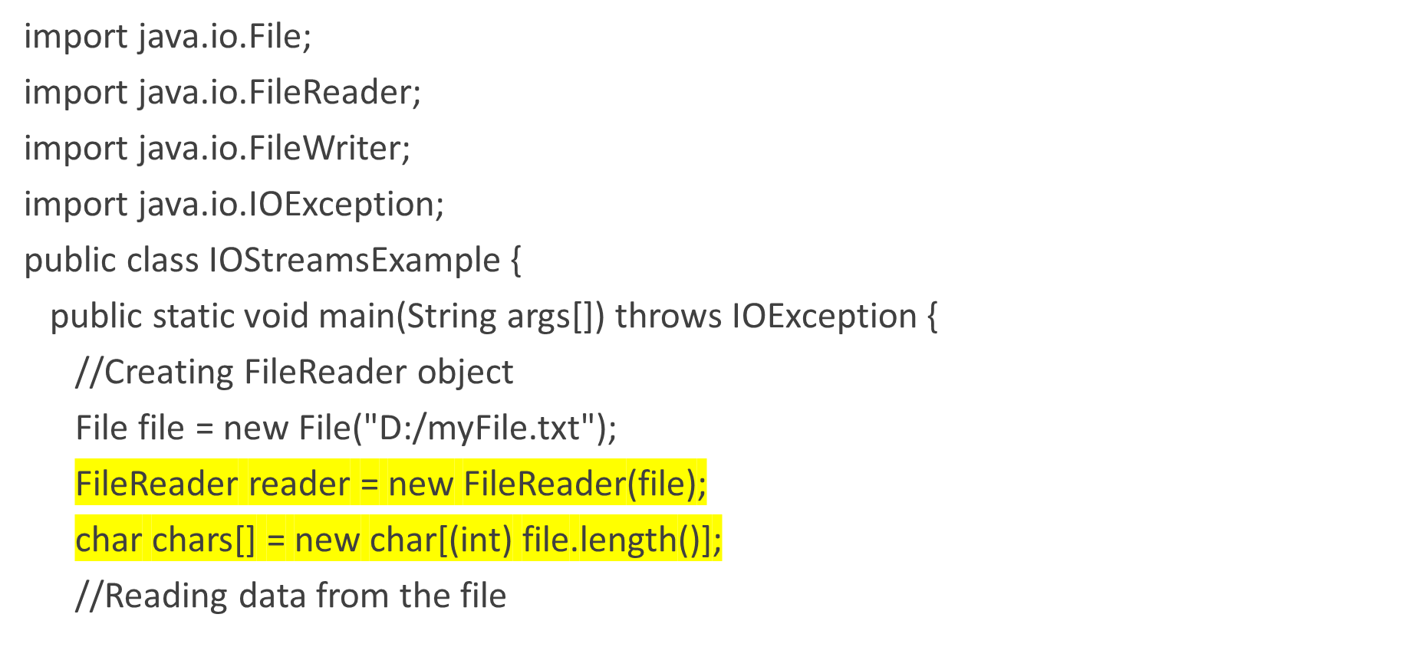
The Character Stream I/O Classes Example

Slide 38
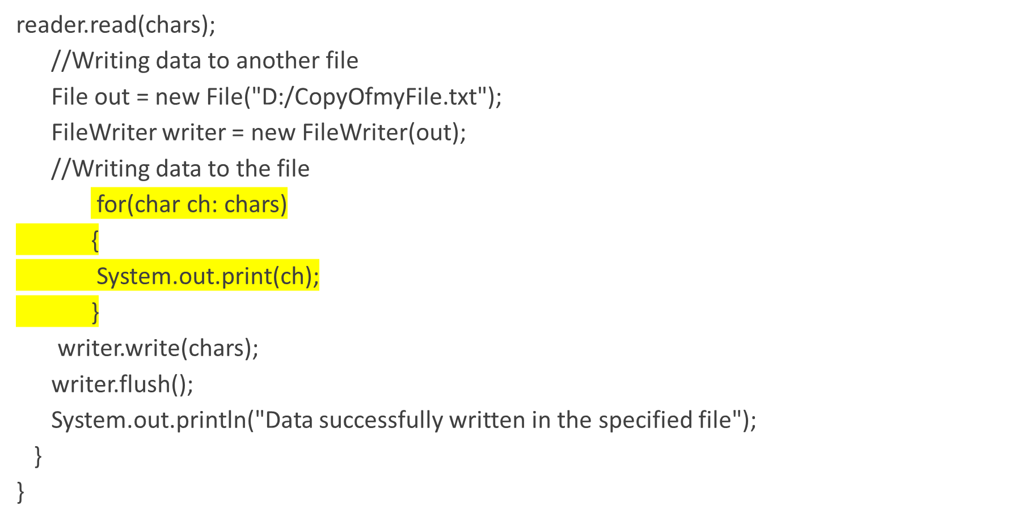
The Character Stream I/O Classes

Slide 39
Predefined Streams
All Java programs automatically import the java.lang package.
This package defines a class called System, which encapsulates several aspects of the run-time environment.
System also contains three predefined stream variables: in, out, and err.
These fields are declared as public and static within System.

Slide 40
Predefined Streams
System.out refers to the standard output stream. By default, this is the console.
System.in refers to standard input, which is the keyboard by default.
System.err refers to the standard error stream, which also is the console by default.
System.in is an object of type InputStream; System.out and System.err are objects of type PrintStream.

Slide 41
Reading Console Input
3 Ways To Read Java Input
There are three different ways to read the input from Java Console, they are –
Using Java Bufferedreader Class
Scanner Class in Java
Console Class in Java

Slide 42
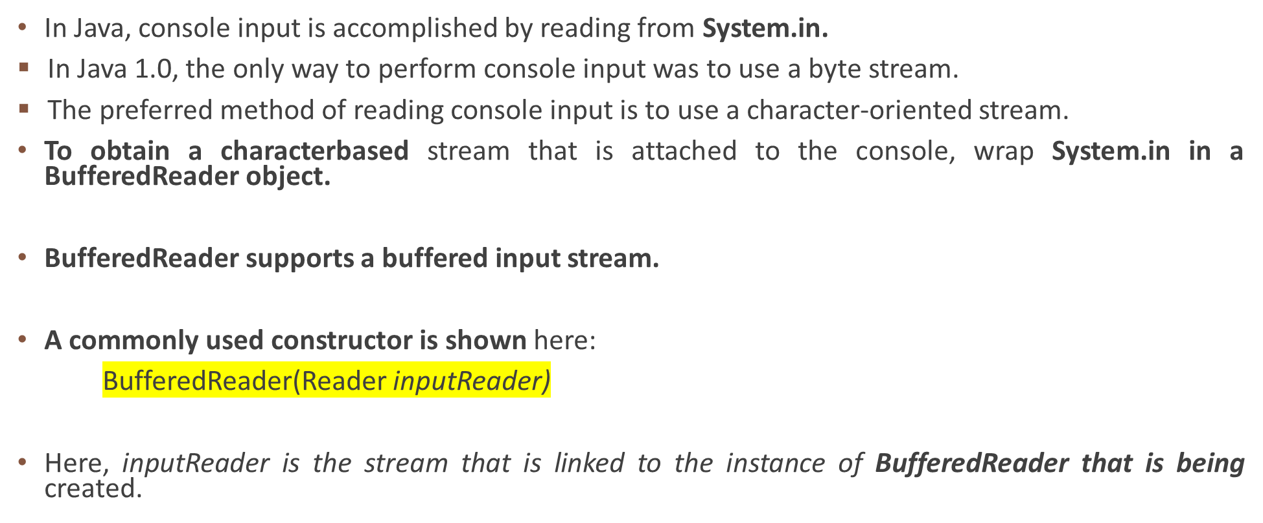
1.Reading Console Input using BufferedReader

Slide 43
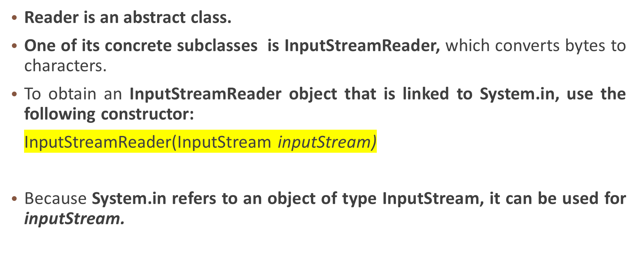
Reading Console Input

Slide 44
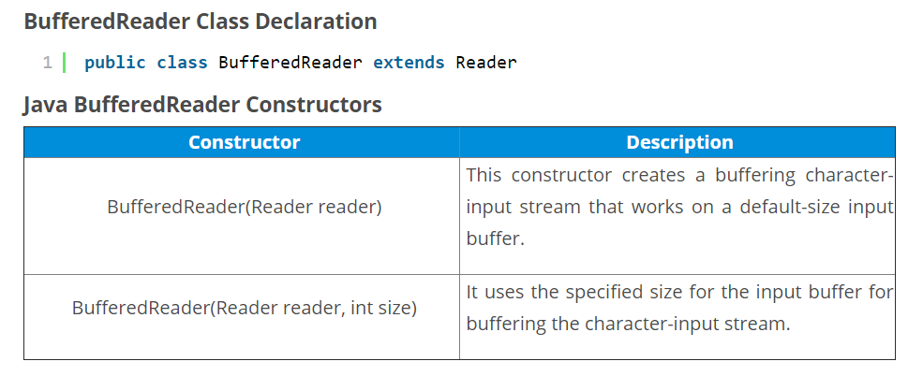
Reading Console Input

Slide 45
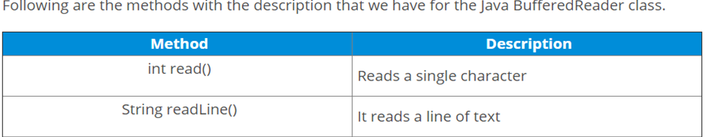
Reading Console Input

Slide 46
Reading Characters
Putting it all together, the following line of code creates a BufferedReader that is connected to the keyboard:
BufferedReader br = new BufferedReader(new
InputStreamReader(System.in));
After this statement executes, br is a character-based stream that is linked to the console through System.in.

Slide 47
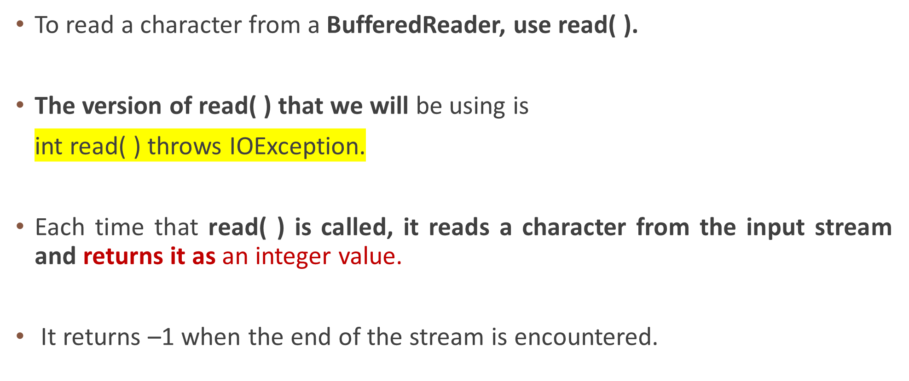
Reading Characters

Slide 48
Reading Characters
BufferedReader br = new BufferedReader (new InputStreamReader (System.in));
System.out.println("Enter character”);
c = (char) br.read();
System.out.println(c);

Slide 49
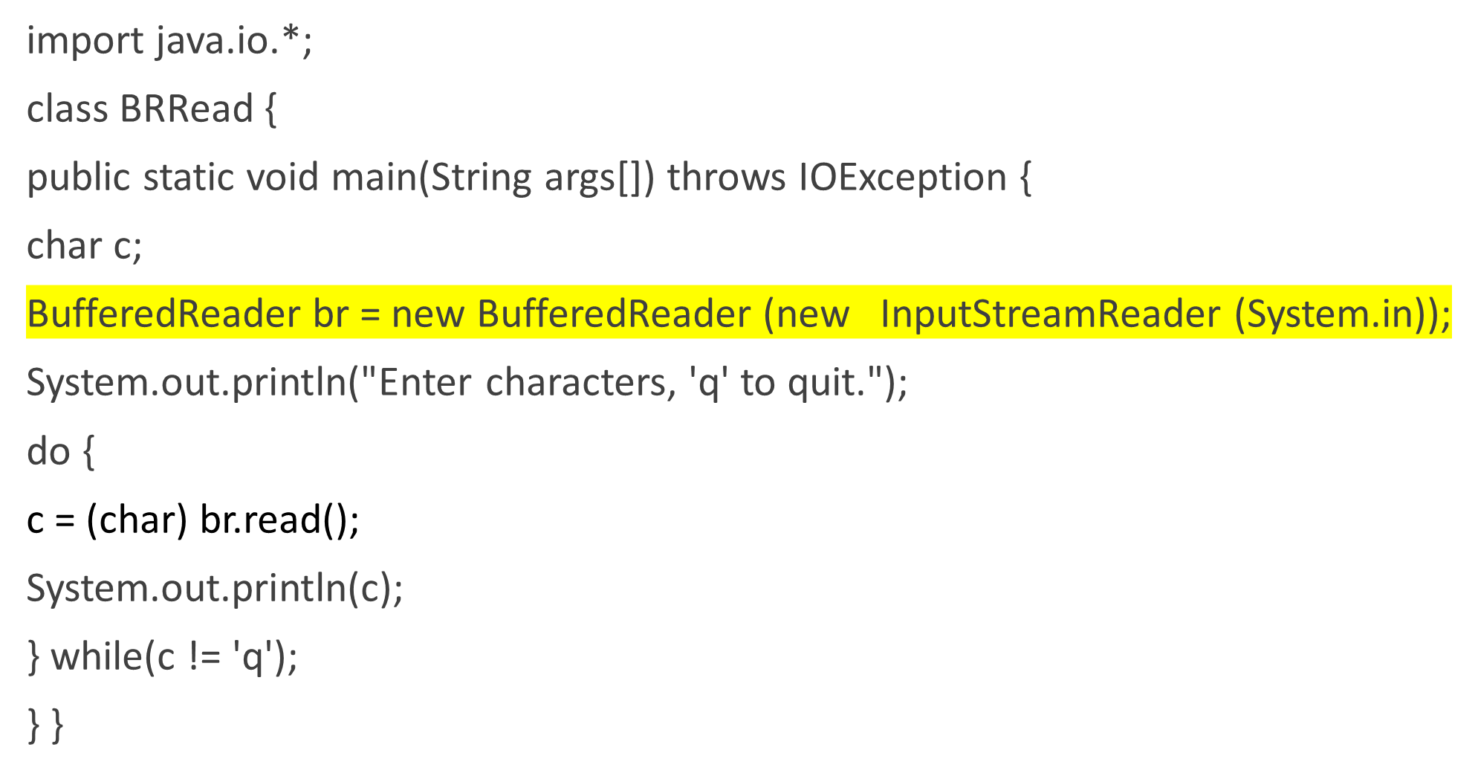

Slide 50
OUTPUT
Enter characters, 'q' to quit.
123abcq
1
2
3
a
b
c
q
System.in is line buffered, by default. This means that no input is actually passed to the program until you press enter.

Slide 51
Reading Strings
To read a string from the keyboard, use the version of readLine( ) that is a member of the BufferedReader class.
Its general form is shown here:
String readLine( ) throws IOException
It returns a String object.

Slide 52
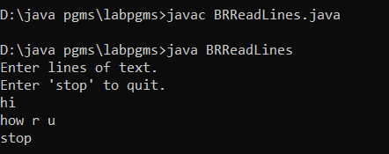
class BRReadLines {
public static void main(String args[]) throws IOException {
BufferedReader br = new BufferedReader(new InputStreamReader(System.in));
String str;
System.out.println("Enter lines of text.");
System.out.println("Enter 'stop' to quit.");
do {
str = br.readLine();
} while(!str.equals("stop"));
}
}

Slide 53
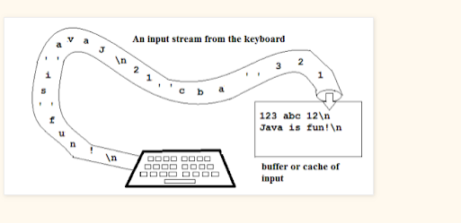
Reading Strings

Slide 54
Difference between BufferedReader and Scanner in Java
1. Buffer Memory :
BufferedReader has larger buffer memory(8KB or 8192 chars) than Scanner which has (1KB or 1024 chars).
It means if you are reading a large String than you should use BufferedReader. If the user input is short or other than String, you can use Scanner.
2. Functionality :
BufferedReader is used to read the data only.
Scanner not only read the data but also parse the data.
Scanner uses regular expression to read and parse text.
It can use custom delimiter and parse text into primitive data type for e,g short,long,int using nextShort(),nextLong(), nextInt() methods.
BufferedReader can only read String using readLine() method.

Slide 55
Difference between BufferedReader and Scanner in Java
3. Performance : BufferedReader is faster than Scanner because BufferedReader does not need to parse the data.
4. Data type : BufferedReader can read only String. Scanner can read String as well as primitive data types (int, float, double, long, short).
5. Introduction to JDK : BufferedReader was introduced in JDK 1.1 while Scanner was introduced in JDK1.5 .
6. Synchronization : BufferedReader is synchronized while Scanner is not. For multi-threading applications BufferedReader is preferred.
7.Package : BufferedReader class is present in java.io package while Scanner class is present in java.util package.

Slide 56
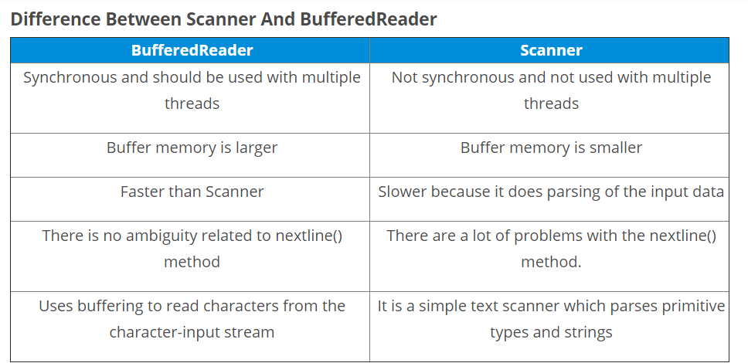

Slide 57
2.Scanner example taking a user input from console
import java.util.*;
public class ScannerExample
{
public static void main(String args[])
{
Scanner sc = new Scanner(System.in);
System.out.println("Enter blog name : ");
String name = sc.nextLine();
StringBuffer sb = new StringBuffer("Hello ");
sb.append(name);
System.out.println(sb);

Slide 58
Scanner example taking a user input from console
System.out.println("Enter gender M/F : ");
char gender = sc.next().charAt(0);
System.out.println("Enter roll no. : ");
long rollnumber = sc.nextLong();
System.out.println(" Scanner is used to read user input");
System.out.println(" gender : " + gender);
System.out.println(" roll number : " + rollnumber);
sc.close();
}
}

Slide 59
Scanner example taking a user input from console
Output :
Enter blog name :
JavaHungry
Hello JavaHungry
Enter gender M/F :
M
Enter roll no. :
01711015
Scanner is used to read user input
gender : M
roll number : 01711015

Slide 60
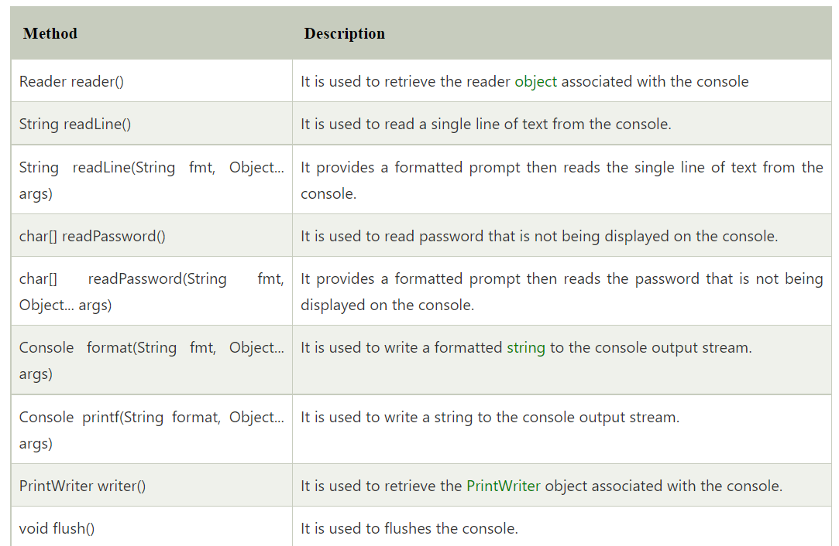
3.Console Class in Java
The Java Console class is be used to get input from console. It provides methods to read texts and passwords.
If you read password using Console class, it will not be displayed to the user.
The java.io.Console class is attached with system console internally.

Slide 61
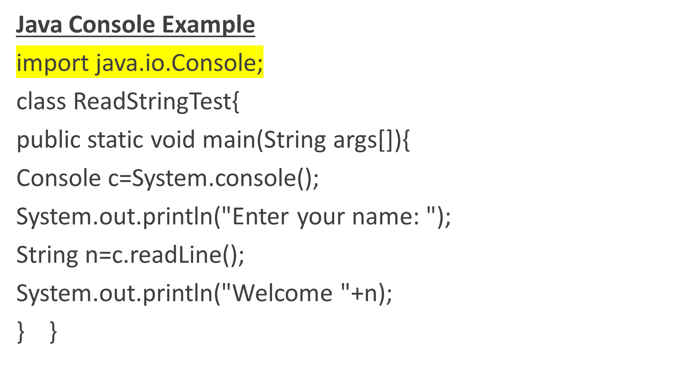
3.Console Class in Java

Slide 62
Writing Console Output
Console output is most easily accomplished with print( ) and println( ) methods defined by the class PrintStream.
PrintStream is an output stream derived from OutputStream, it also implements the low-level method write( ).
The simplest form of write( ) defined by PrintStream:
void write(int byteval)
This method writes the byte specified by byteval. Although byteval is declared as an integer, only the low-order eight bits are written.

Slide 63
Writing Console Output
// Demonstrate System.out.write().
import java.io.*;
class WriteDemo {
public static void main(String args[]) {
int b,c;
c =11111;//convert to binary ,take low 8 bit 1100111,which is 103 ascii of g
b = 'A';
System.out.write(b);
System.out.write('\n');
System.out.write(c);
System.out.write('\n');

Slide 64
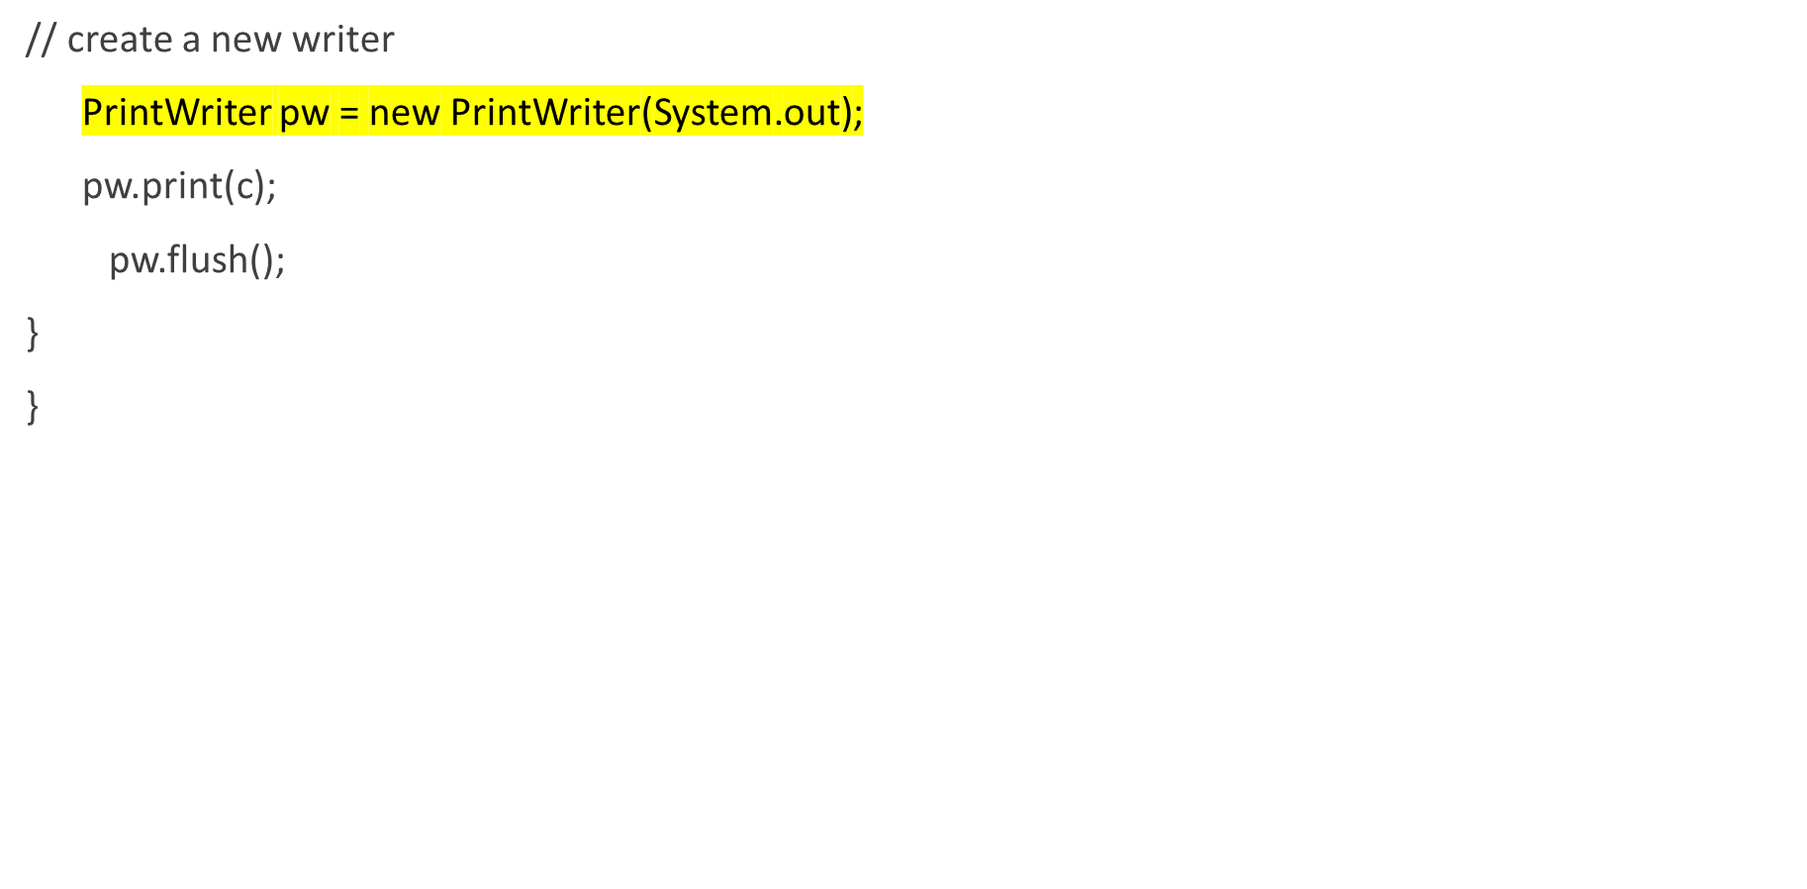
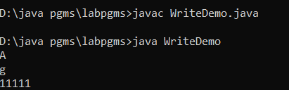
Writing Console Output

Slide 65
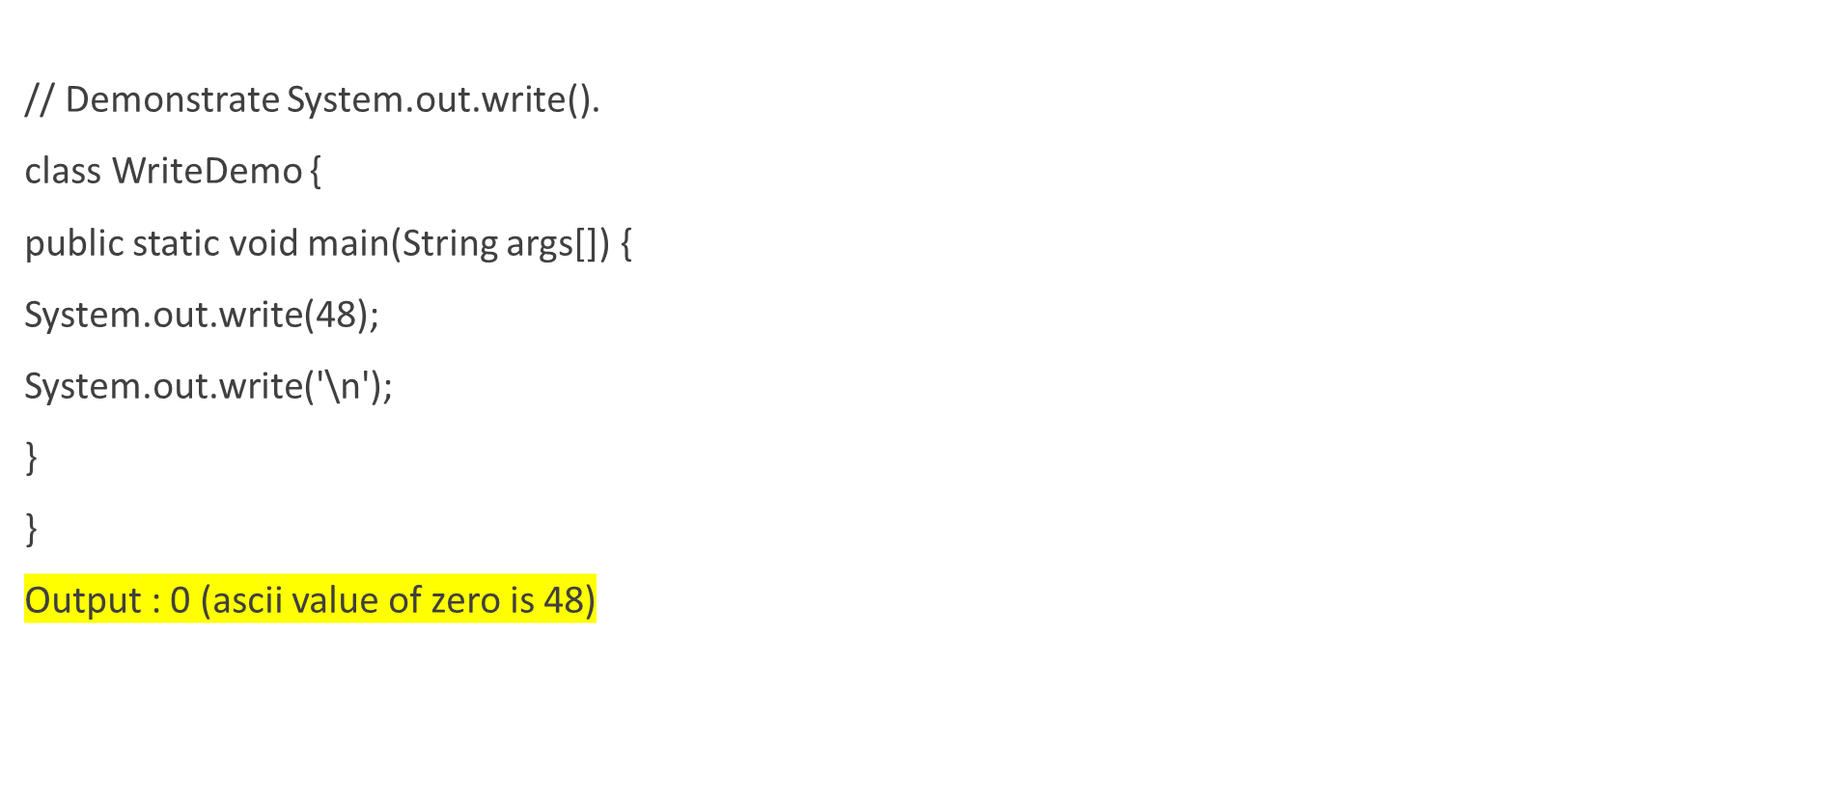
Writing Console Output

Slide 66
The PrintWriter Class
PrintWriter is one of the character-based classes.
PrintWriter defines several constructors.
PrintWriter(OutputStream outputStream, boolean flushingOn)
outputStream is an object of type OutputStream, and flushingOn controls whether Java flushes the output stream every time a println( ) method is called.
If flushingOn is true, flushing automatically takes place. If false, flushing is not automatic.

Slide 67
The PrintWriter Class
PrintWriter supports the print( ) and println( ) methods.
To write to the console by using a PrintWriter, specify System.out for the output stream and automatic flushing.
PrintWriter pw = new PrintWriter(System.out, true);

Slide 68
System.out to write vs PrintWriter stream.
System.out to write to the console is acceptable, its use is recommended mostly for debugging purposes or for sample programs.
For real-world programs, the recommended method of writing to the console when using Java is through a PrintWriter stream.
PrintWriter is one of the character-based classes.
Using a character-based class for console output makes it easier to internationalize your program.

Slide 69
import java.io.*;
public class PrintWriterDemo {
public static void main(String args[]) {
PrintWriter pw = new PrintWriter(System.out, true);
pw.println("This is a string");
int i = -7;
pw.println(i);
double d = 4.5e-7;
pw.println(d);
} }

Slide 70
The PrintWriter Class
The output from this program is shown here:
  This is a string
  -7
  4.5E-7

Slide 71
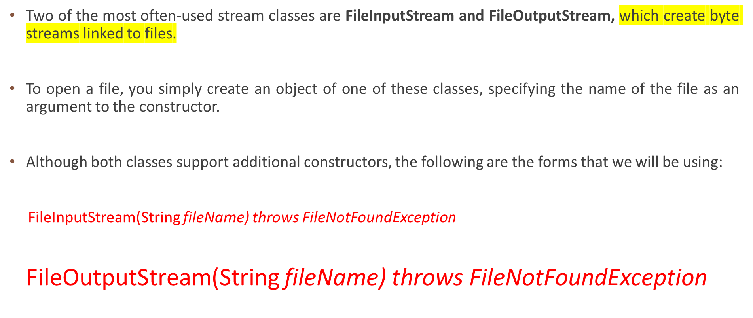
Reading and Writing Files

Slide 72
Reading and Writing Files
Here, fileName specifies the name of the file that you want to open.
When you create an input stream, if the file does not exist, then FileNotFoundException is thrown.
For output streams, if the file cannot be opened or created, then FileNotFoundException is thrown.
FileNotFoundException is a subclass of IOException.
When an output file is opened, any preexisting file by the same name is destroyed.

Slide 73
Reading and Writing Files
When you are done with a file, you must close it. This is done by calling the close( ) method, which is implemented by both FileInputStream and FileOutputStream.
void close( ) throws IOException
Closing a file releases the system resources allocated to the file, allowing them to be used by another file.
Failure to close a file can result in “memory leaks” because of unused resources remaining allocated.

Slide 74
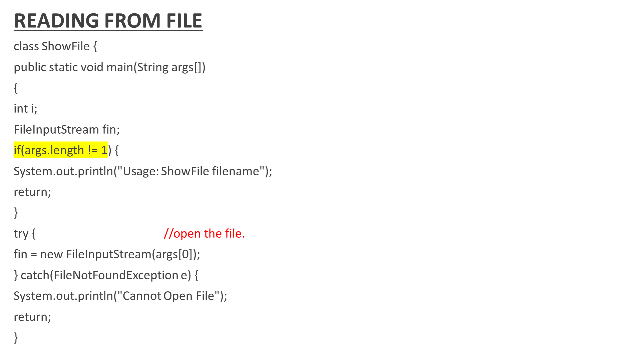

Slide 75
// The following reads characters until EOF is encountered.
try {
do {
i = fin.read();
if(i != -1) System.out.print((char) i);
} while(i != -1);
} catch(IOException e) {
System.out.println("Error Reading File");
}
// Close the file.
try {
fin.close();
} catch(IOException e) {
System.out.println("Error Closing File");
}
}
}

Slide 76
Reading and Writing Files
To write to a file, you can use the write( ) method defined by FileOutputStream.
void write(int byteval) throws IOException
This method writes the byte specified by byteval to the file.
Although byteval is declared as an integer, only the low-order eight bits are written to the file.
If an error occurs during writing, an IOException is thrown.

Slide 77
Reading and Writing Files
class CopyFile {
public static void main(String args[]) throws IOException
{
int i;
FileInputStream fin = null;
FileOutputStream fout = null;
if(args.length != 2) {
System.out.println("Usage: CopyFile from to");
return;
}

Slide 78
try {
// Attempt to open the files.
fin = new FileInputStream(args[0]);
fout = new FileOutputStream(args[1]);
do {
i = fin.read();
if(i != -1) fout.write(i);
} while(i != -1);
} catch(IOException e) {
System.out.println("I/O Error: " + e);
}

Slide 79
finally {
try {
if(fin != null) fin.close();
} catch(IOException e2) {
System.out.println("Error Closing Input File");
}
try {
if(fout != null) fout.close();
} catch(IOException e2) {
System.out.println("Error Closing Output File");
}
}
}
}

Slide 80
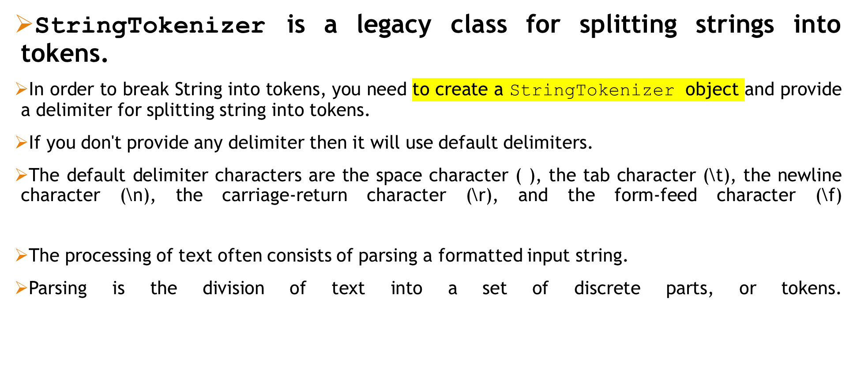
StringTokenizer

Slide 81
StringTokenizer
To use StringTokenizer, you specify an input string and a string that contains delimiters.
Delimiters are characters that separate tokens.
The default set of delimiters consists of the whitespace characters: space, tab,newline, and carriage return.
The StringTokenizer constructors are shown here:
StringTokenizer(String str)
StringTokenizer(String str, String delimiters)

Slide 82
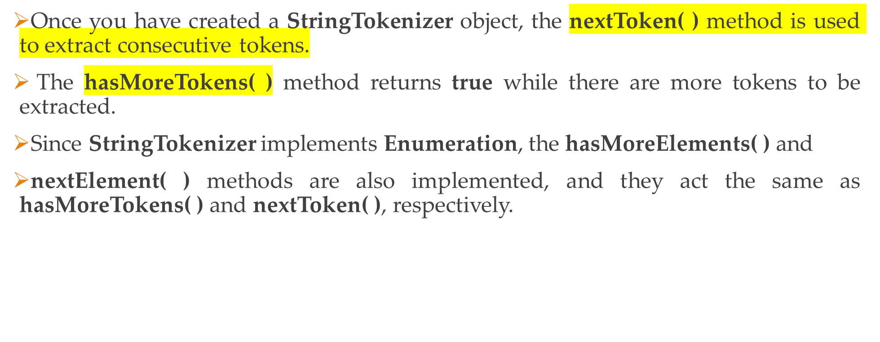
StringTokenizer

Slide 83
StringTokenizer
String str = "I am sample string ";
StringTokenizer defaultTokenizer = new StringTokenizer(str);
System.out.println("Total number of tokens found : " + defaultTokenizer.countTokens());
Total number of tokens found : 4
I
am
sample
string

Slide 84
StringTokenizer
String url = "https://howtodoinjava.com/java-initerview-questions";
StringTokenizer multiTokenizer = new StringTokenizer(url, "://.-");
https
howtodoinjava
com
java
initerview
questions

Slide 85
Write a Java program that reads a line of integers, and then displays each integer, and the sum of all the integers [Use String Tokenizer class of java.util[Use String Tokenizer class of java.util]

Slide 86
CONCLUSION
The io package supports Java’s basic I/O (input/output) system, including file I/O.
Java programs perform I/O through streams.
There are 2 kinds of streams
  byte streams
  character streams
Byte streams provide a convenient means for handling input and output of bytes.
Character streams provide a convenient means for handling input and output of characters.

